Slide 1
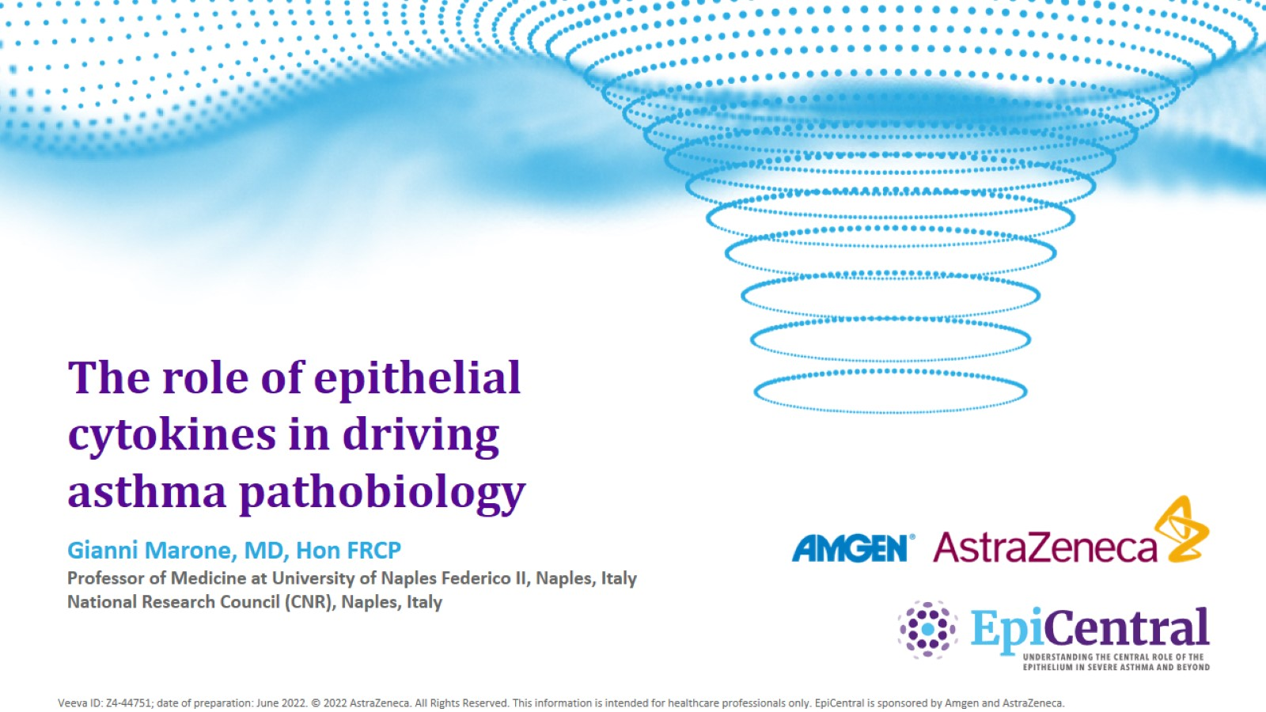
The role of epithelial cytokines in driving asthma pathobiology

Slide 2
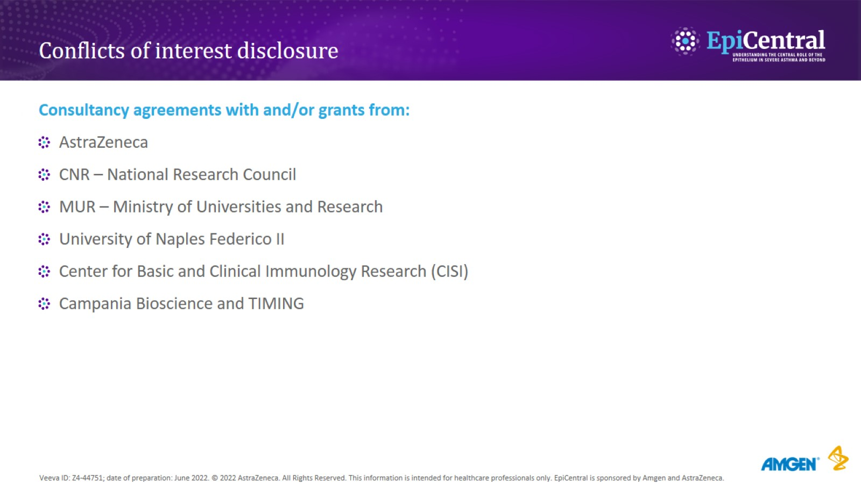
Conflicts of interest disclosure

Slide 3
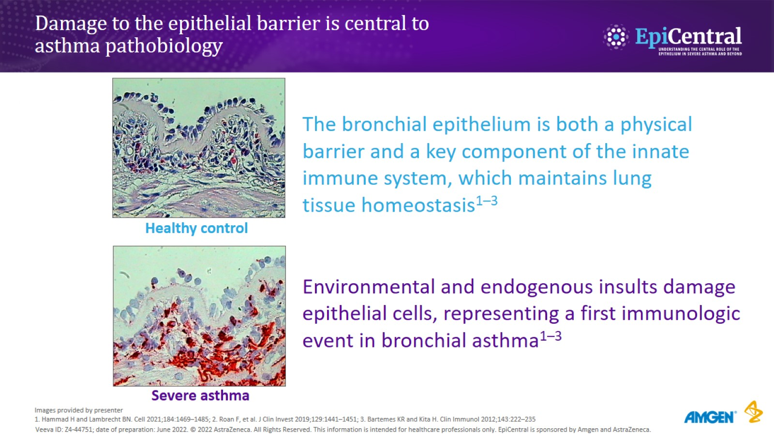
Damage to the epithelial barrier is central to asthma pathobiology

Slide 4
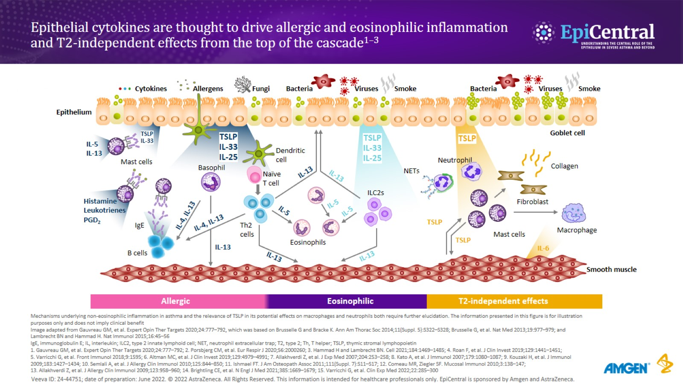
Epithelial cytokines are thought to drive allergic and eosinophilic inflammation and T2-independent effects from the top of the cascade^{1–3}

Slide 5
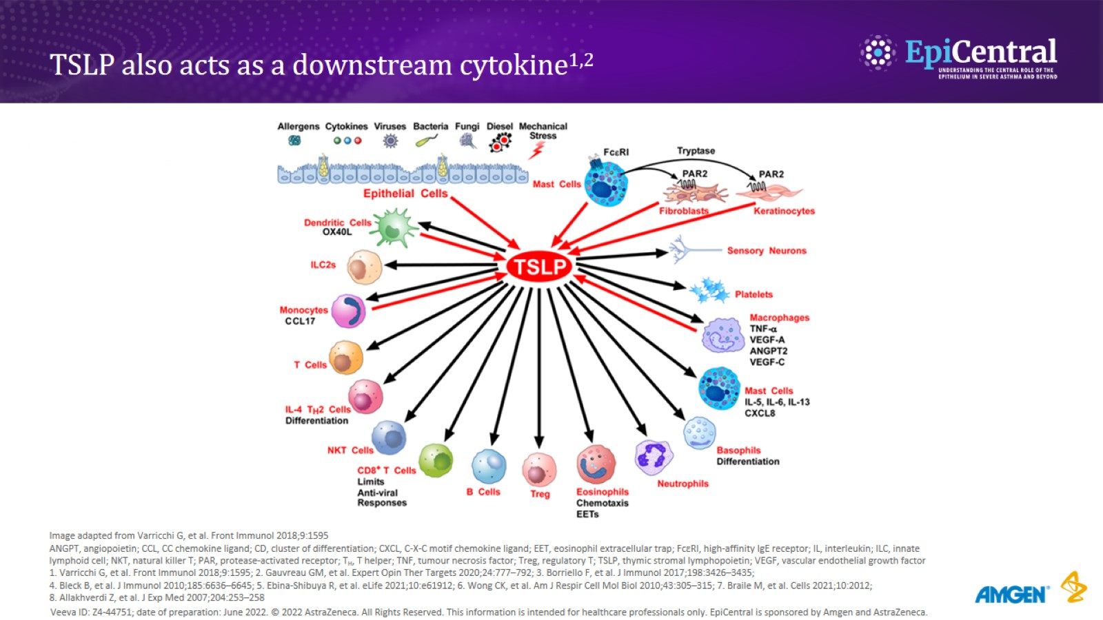
TSLP also acts as a downstream cytokine^{1,2}

Slide 6
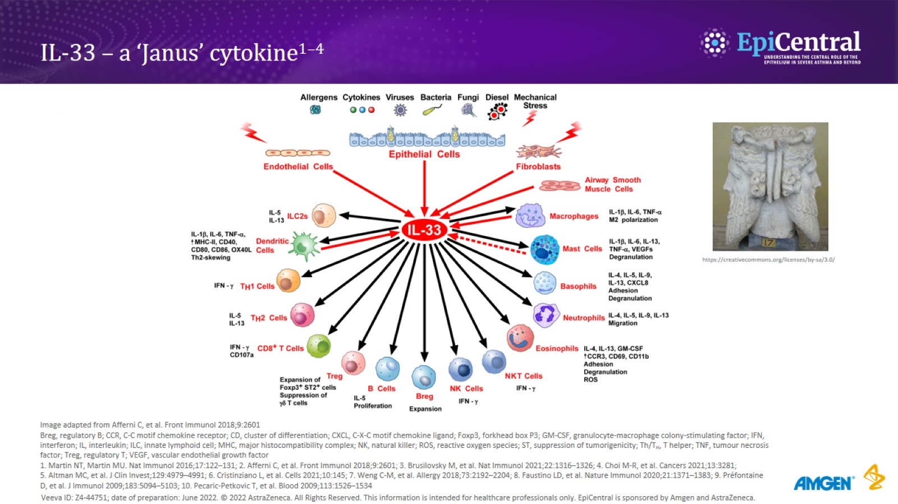
IL-33 – a ‘Janus’ cytokine^{1–4}

Slide 7
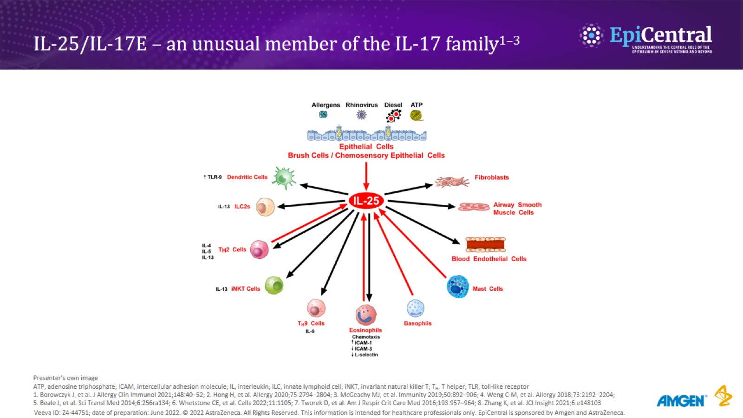
IL-25/IL-17E – an unusual member of the IL-17 family^{1–3}

Slide 8
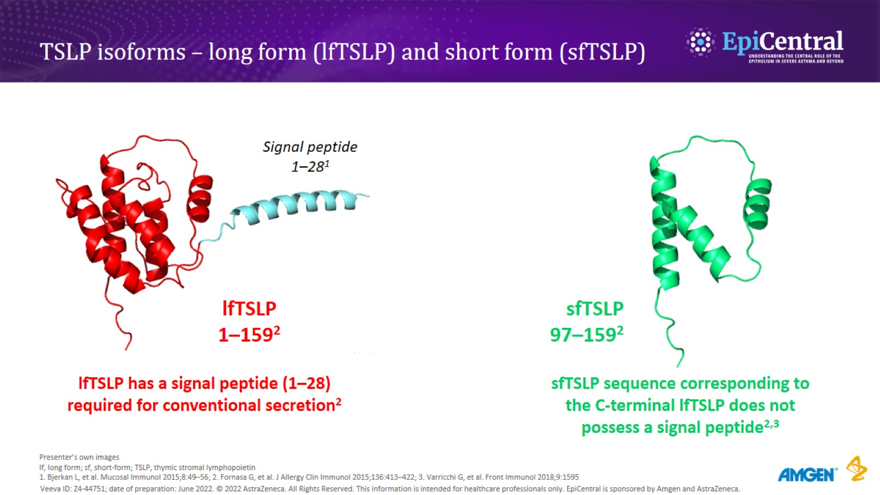
TSLP isoforms – long form (lfTSLP) and short form (sfTSLP)

Slide 9
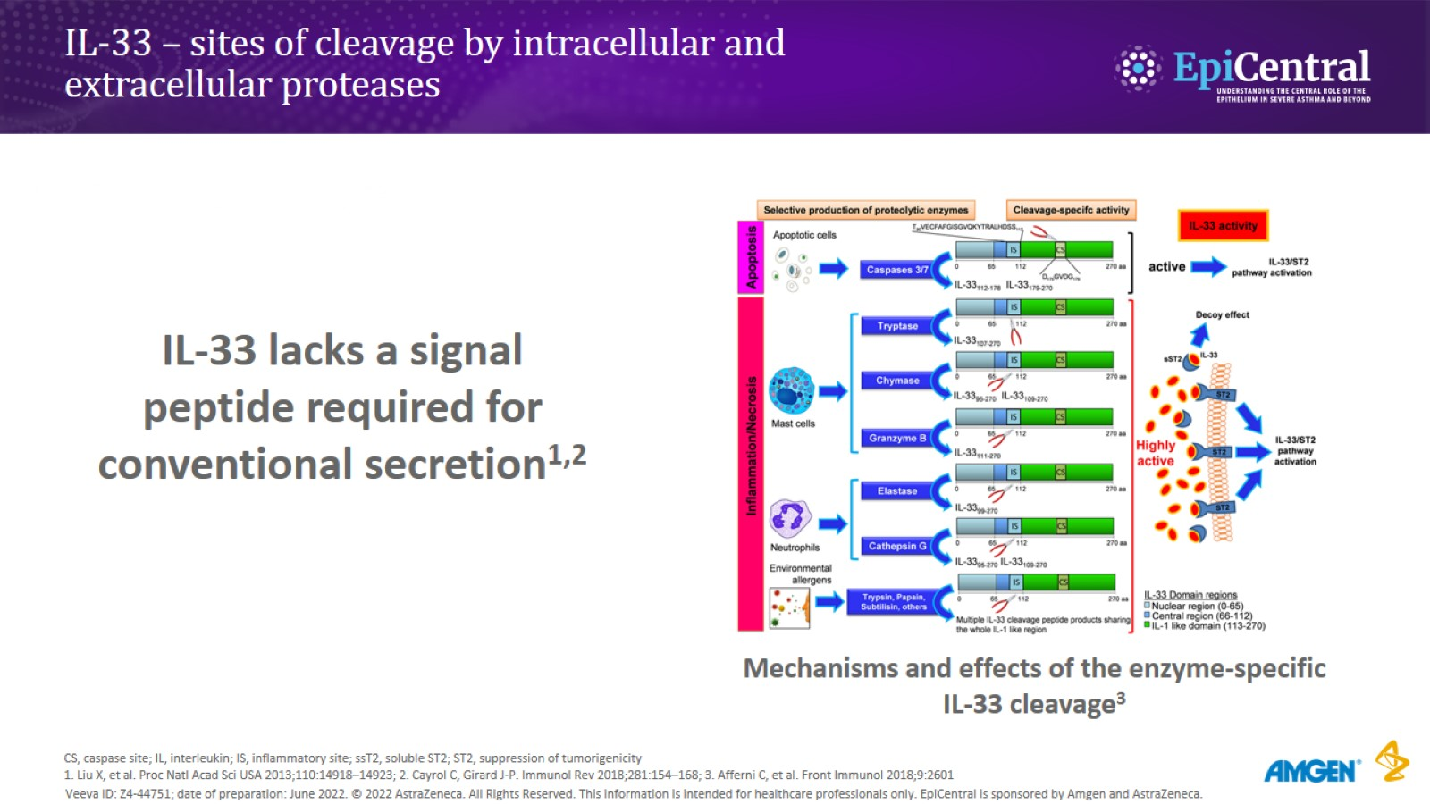
IL-33 – sites of cleavage by intracellular and extracellular proteases

Slide 10
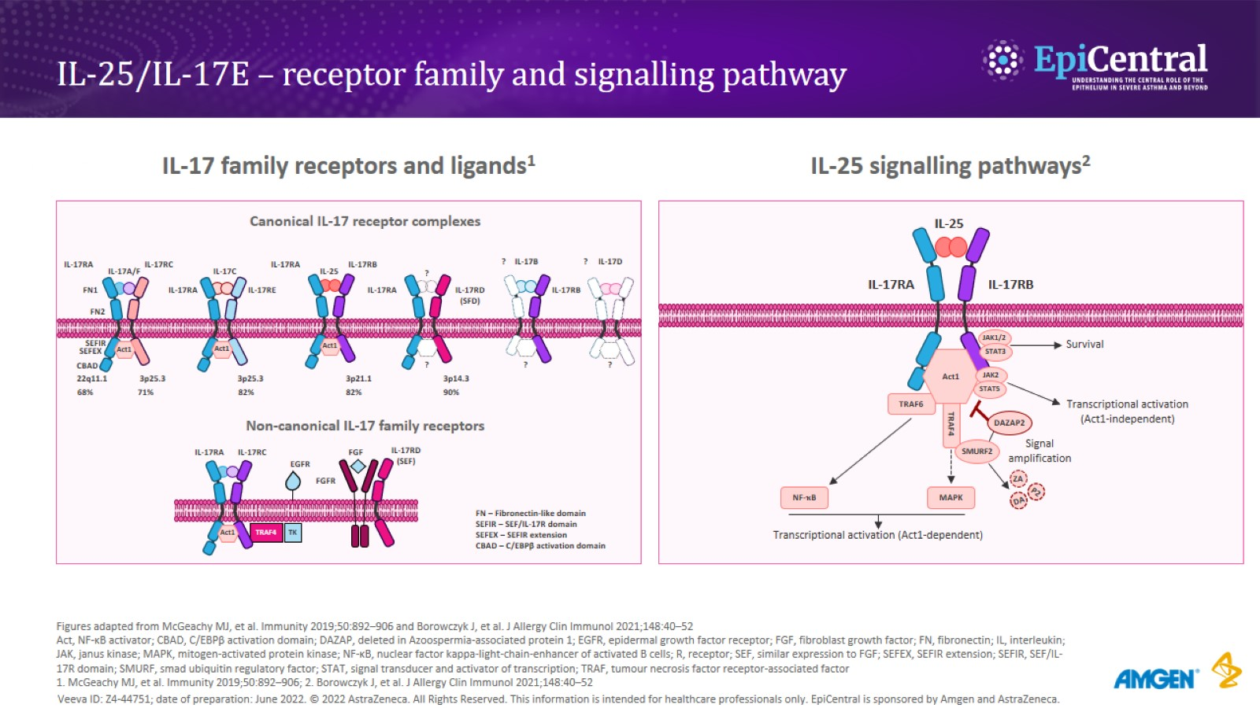
IL-25/IL-17E – receptor family and signalling pathway

Slide 11
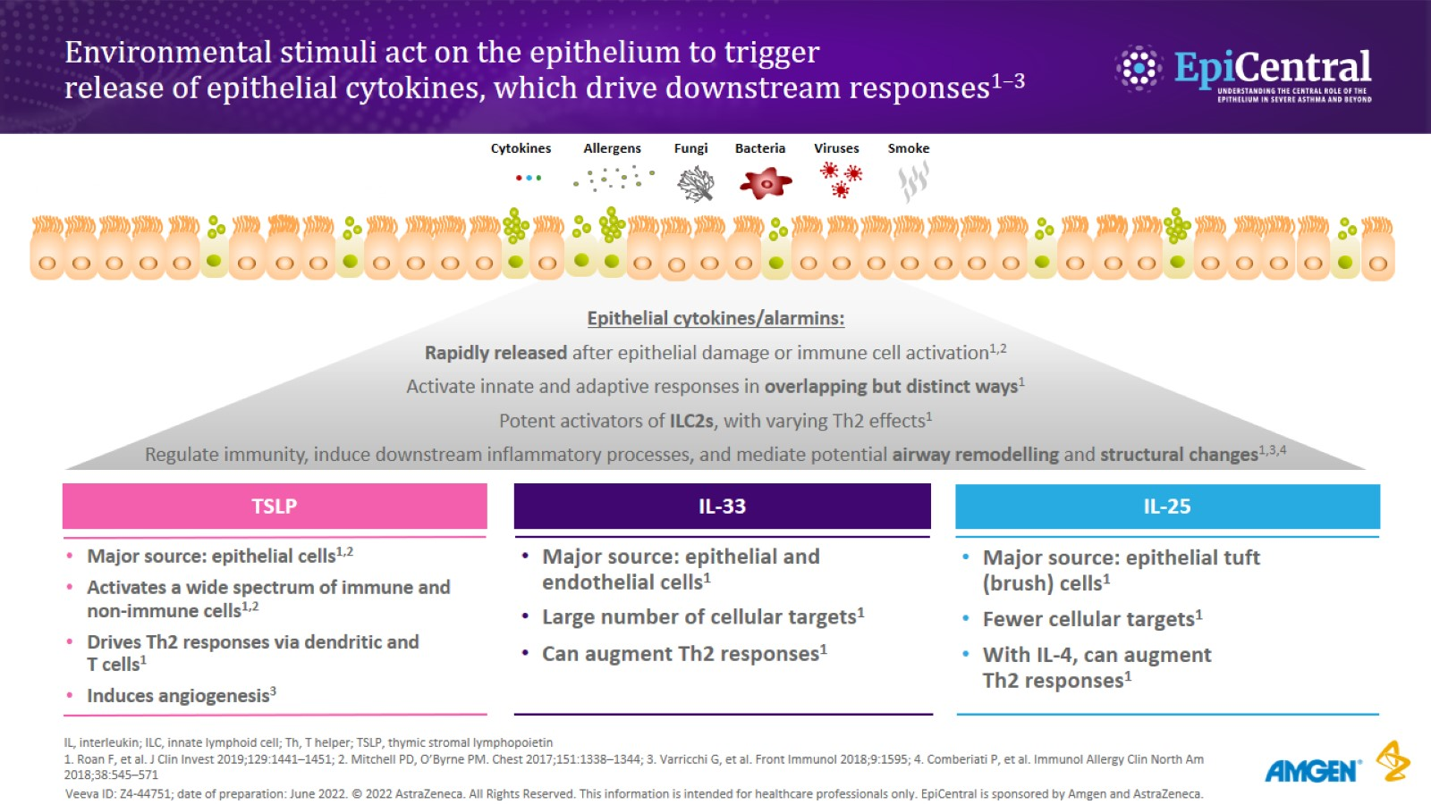
Environmental stimuli act on the epithelium to trigger release of epithelial cytokines, which drive downstream responses^{1–3}

Slide 12
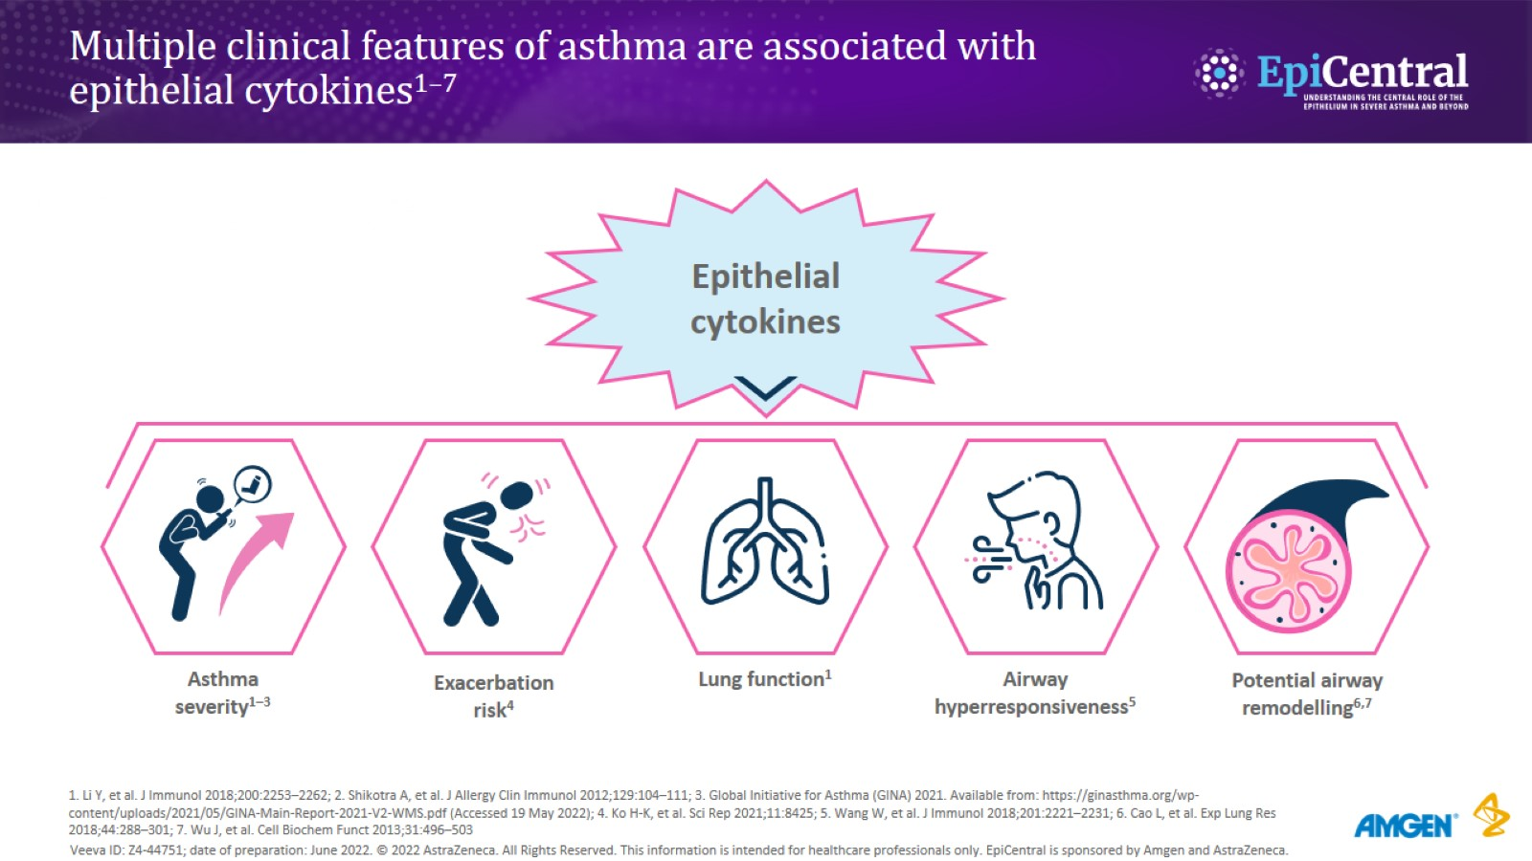
Multiple clinical features of asthma are associated with epithelial cytokines^{1–7}

Slide 13
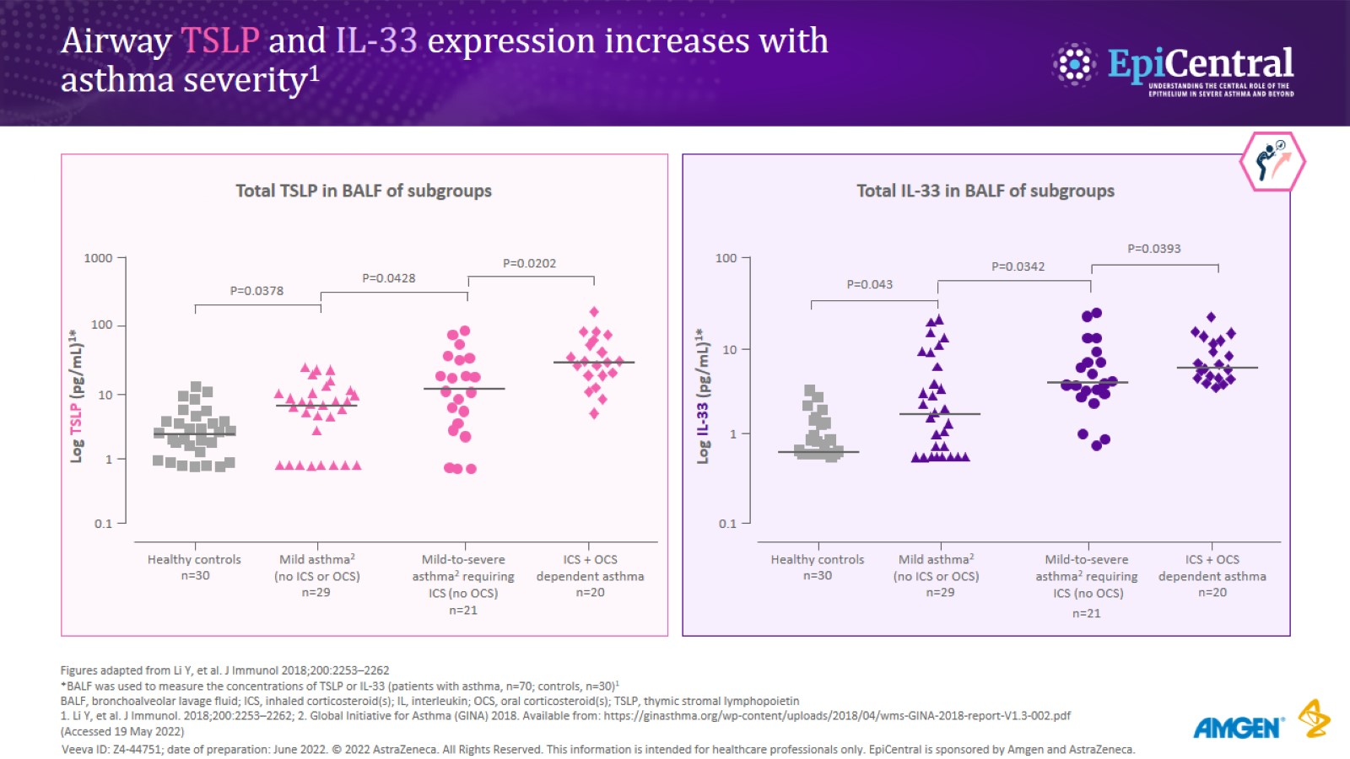
Airway TSLP and IL-33 expression increases with asthma severity¹

Slide 14
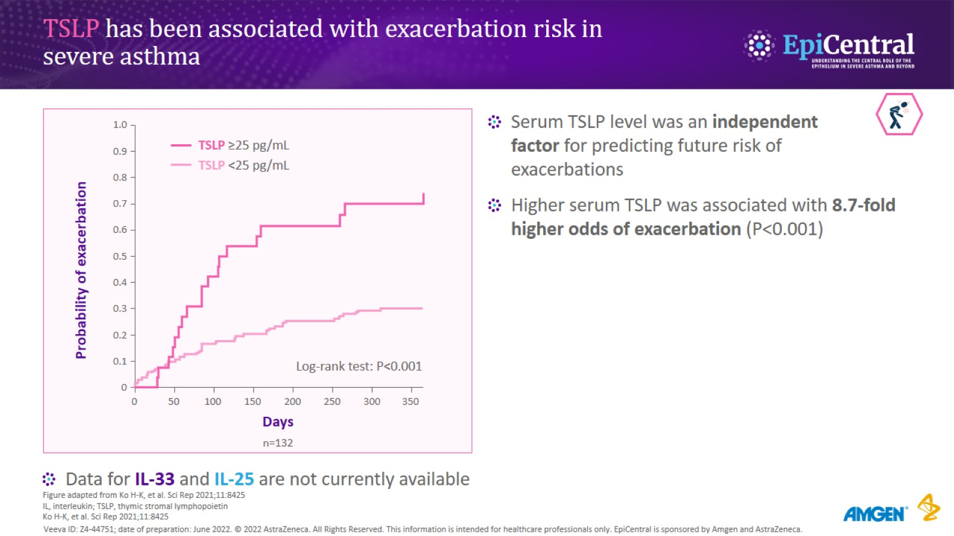
TSLP has been associated with exacerbation risk in severe asthma

Slide 15
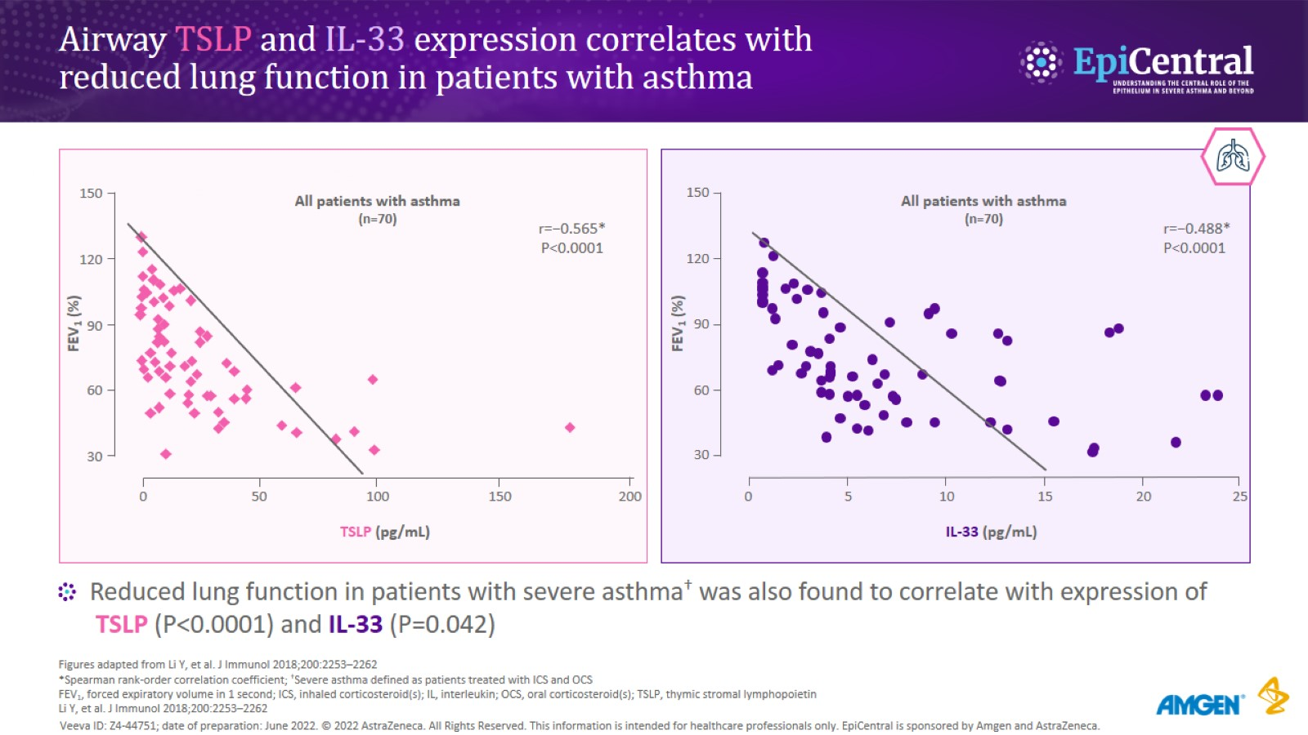
Airway TSLP and IL-33 expression correlates with reduced lung function in patients with asthma

Slide 16
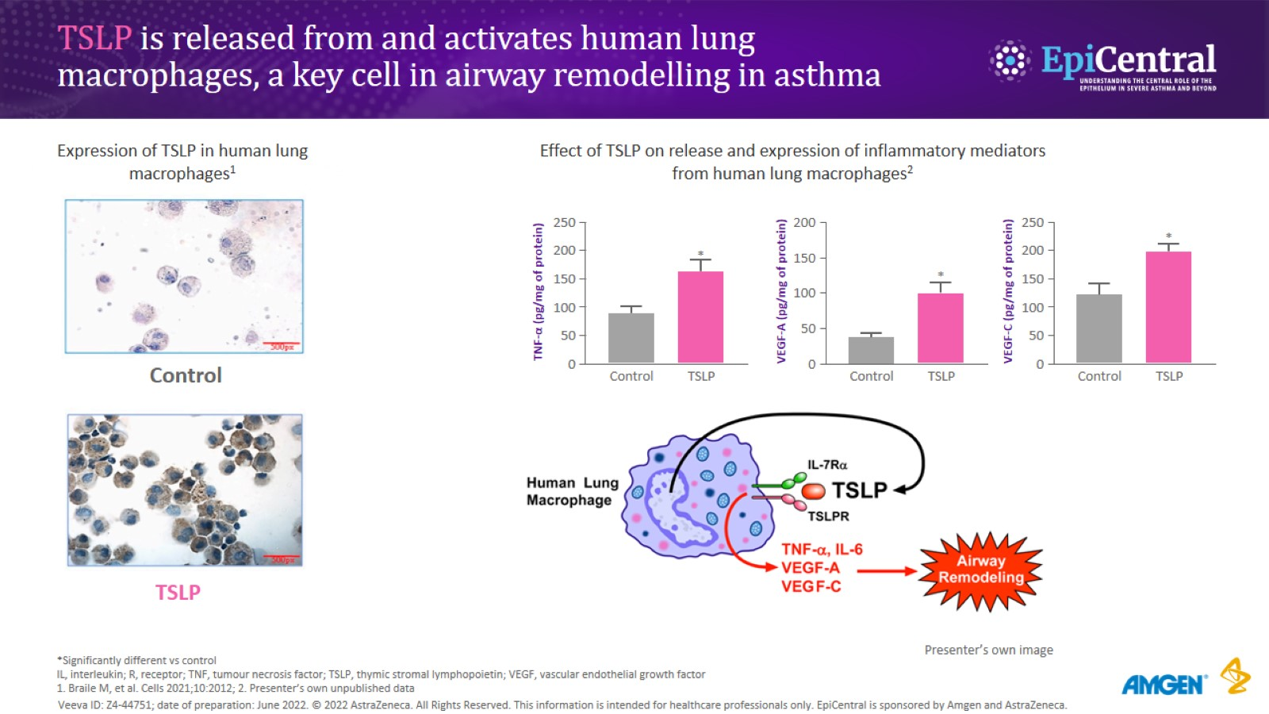
TSLP is released from and activates human lung macrophages, a key cell in airway remodelling in asthma

Slide 17
Multiple clinical features of asthma are associated with epithelial cytokines^{1–7}

Slide 18

Thank you for your kind attention

